Slide 1


EdgeWake
Tiered Cascade Guardian
Ultra-Low-Power Forest Surveillance
"Our system only speaks when spoken to by a disaster."
01

Slide 2

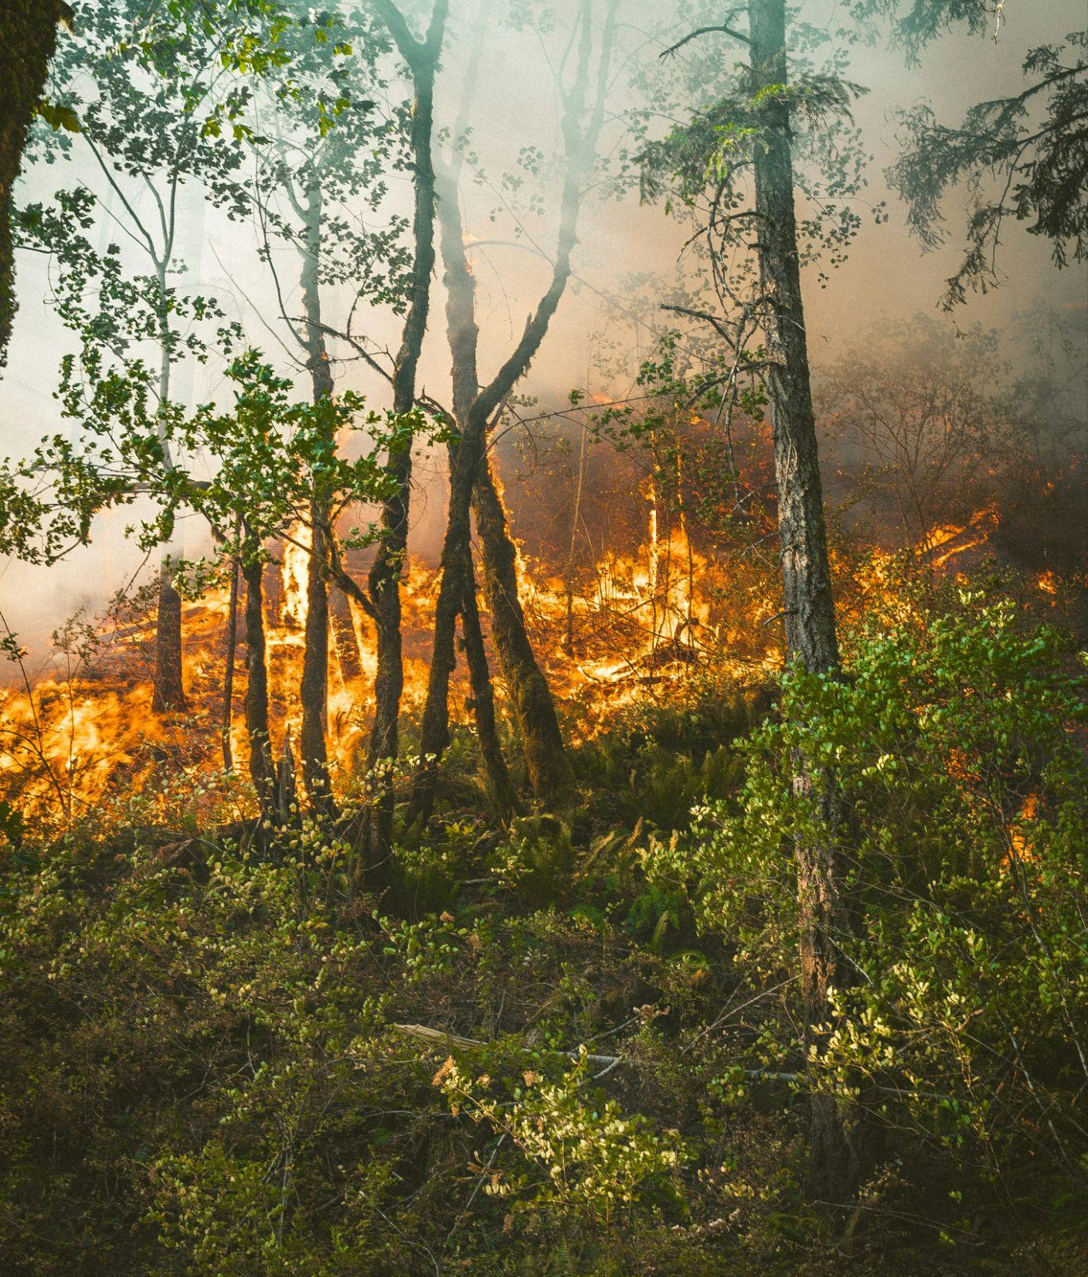
The Problem Why Forest Sensors Fail
■
Forest fires destroy 10+ million hectares globally every year.
■
Illegal logging and poaching go undetected in remote, unmonitored areas.
■
Existing IoT sensors rely on fixed-schedule cloud communication.
■
Constant Wi-Fi and sensor polling drains batteries in days, not months.
■
Replacing batteries in dense forests is highly impractical and expensive.
■
Result: Sensors die long before they detect a real threat.
02

Slide 3

EdgeWake — The Solution
An ultra-low-power, multi-modal edge AI node that sleeps 99% of the time.
→
Instead of constantly polling the cloud, EdgeWake uses low-power analog tripwires (flame sensor, vibration sensor).
→
These analog sensors WAKE UP high-power systems (microphone, camera, Wi-Fi) ONLY when a real threat is detected.
→
The device spends 99% of its life in deep sleep (~10 µA) and only uses full power (~160 mA) for 5 seconds during an actual alert.
→
Battery life: Extended to months or years instead of mere days.
03

Slide 4
What Makes EdgeWake Different?
Feature | Traditional Sensor | EdgeWake System
Power Mode | Always ON | Deep Sleep (99%)
Cloud Comms | Every 30 seconds | Only on confirmed threat
Battery Life | 2–7 days | 6–18 months
False Alarms | Sends everything to cloud | 3-stage Edge verification
Intelligence | Cloud-only processing | Edge AI on device
Sensors | Single mode | Multi-modal (IR + Audio + Vision)
04

Slide 5
The Tiered Cascade Architecture
5 tiers from zero-power to full-alert in under 5 seconds.
Tier 2 HW Interrupt
Tier 4 Visual Capture
Current: ~20 mA Tripwire triggered
Current: ~120 mA JPEG Evidence
Tier 1 Deep Sleep
Tier 3 Audio Verif.
Tier 5 Cloud Handoff
Current: ~10 µA Sensors active
Current: ~40 mA Edge AI filtering
Current: ~160 mA Send & Sleep
05

Slide 6



Tier 1 — Deep Sleep (Near-Zero Power)
Powered Down
Analog Tripwires Active
The main ESP32 CPU, Wi-Fi radio, and camera module are physically powered OFF.
Two critical analog sensors remain powered, waiting for anomalies:
Only the ULP (Ultra Low Power) co-processor remains minimally active to monitor the environment.
→
Flame Sensor: (IR receiver) on GPIO 13
→
Vibration Sensor: (SW-420) on GPIO 2
Current Draw: ~10 µA
The system uses ext1 hardware wake-up — the CPU does NOT poll. It is woken solely by a voltage spike on these sensor pins.
Enough to last months on a single 18650 battery.
06

Slide 7



Tier 2 — Hardware Interrupt (The Tripwire)
The Trigger Event
Instant Wake-up
An environmental anomaly occurs (e.g., flash of fire, illegal logging chainsaw, or landslide).
This triggers an ext1 hardware wake-up. The ESP32 powers on instantly.
The flame sensor detects infrared radiation OR the vibration sensor detects abnormal ground vibration.
Firmware identifies WHICH sensor fired by reading the ext1 bitmask:
The sensor sends a HIGH voltage signal directly to an RTC GPIO pin.
•
GPIO 13 HIGH: "Fire" alert
•
GPIO 2 HIGH: "Abnormal Vibration"
Debounce logic prevents repeated false triggers.
07

Slide 8




Tier 3 — Edge Audio Verification
Before activating the power-hungry camera, the system verifies the threat using sound.
The INMP441 I2S microphone records 2 seconds of audio at 16 kHz.
Two Analysis Modes:
→
Simple: RMS energy threshold (fast, effective).
→
TinyML: Edge Impulse model classifies sounds as "fire", "chainsaw", or "background".
Threat Confirmed: Proceed to camera.
False Alarm: Back to sleep instantly.
08

Slide 9


Tier 4 — Visual Evidence Capture
Irrefutable Proof
This tier is only reached if audio verification confirms a real threat exists, saving massive amounts of power over the device's lifetime.
→
The OV2640 camera module powers on.
→
Captures a single high-resolution JPEG (800×600).
→
Flash LED fires briefly for illumination in low-light, dense forest conditions.
→
Uses PSRAM for high-resolution frame buffers.
The photo serves as court-admissible evidence for illegal logging prosecution or fire insurance claims.
09

Slide 10



Tier 5 — Cloud Handoff & Instant Sleep
Burst Transmission
Return to Zero
The ESP32 briefly connects to Wi-Fi (typically taking < 3 seconds).
After the server responds with 200 OK, confirming receipt, Wi-Fi is immediately severed.
Sends a multipart HTTP POST to an n8n webhook containing critical data:
The device forces itself back into Tier 1 Deep Sleep within milliseconds.
→
The JPEG evidence photo
→
Alert type ("Fire" or "Vibration")
Total Awake Time: ~5 seconds
The threat is reported, and the battery is protected.
→
Device ID and GPS/location
→
Audio RMS energy value & Timestamp
10

Slide 11






Cloud-Side Automation with n8n
All heavy processing is offloaded to the cloud to save ESP32 power.
1. Webhook
2. Smart Router
3. Secure Storage
4. Instant Alert
Receives the multipart POST alert from the EdgeWake ESP32 node.
Routes payload dynamically by alert type (Fire / Vibration / Intruder).
Stores the high-res evidence photo in Drive with a timestamped filename.
Pushes photo + emergency message directly to the user's phone.
11

Slide 12
Hardware Bill of Materials
Component | Model | Purpose | Cost (approx.)
Microcontroller | ESP32-CAM (AI-Thinker) | Main brain + OV2640 camera | ₹500
Programmer | FTDI USB-to-TTL (CP2102) | Upload firmware | ₹150
Microphone | INMP441 I2S MEMS Mic | Audio verification (Tier 3) | ₹200
Flame Sensor | Generic IR Flame Module | Fire detection tripwire (Tier 2) | ₹50
Vibration Sensor | SW-420 | Logging/movement tripwire | ₹40
Power | 18650 Li-ion + TP4056 | Long-life battery supply | ₹200
TOTAL COST PER NODE | ~₹1,140
12

Slide 13


Wiring & Pin Assignments
Core Connections:
→
Flame Sensor DO → GPIO 13 (RTC ext1)
→
Vibration Sensor DO → GPIO 2 (RTC ext1)
→
Camera: Built-in OV2640 (Internal)
→
Power: 5V via 18650+TP4056+MT3608
GPIO | Function | Module
2 | ext1 Wake | SW-420
4 | Flash LED | Built-in
12 | I2S Data In | INMP441
13 | ext1 Wake | Flame Sensor
14 | I2S Word Select | INMP441
15 | I2S Clock | INMP441
13

Slide 14






Software & Technology Stack
Edge Layer (ESP32)
AI Layer (TinyML)
Cloud / App Layer
Arduino C++ (ESP-IDF)
Edge Impulse
n8n & Web Dashboard
•
esp_sleep.h — deep sleep
•
TensorFlow Lite for Microcontrollers
•
n8n (open-source automation)
•
esp_camera.h — OV2640 capture
•
HTML5/CSS3/JS Web Dashboard
•
driver/i2s.h — INMP441 mic
•
MFCC feature extraction
•
HTTPClient.h — multipart POST
•
Neural classifier (Fire/Chainsaw)
•
Real-time cascade simulation
•
Telegram API integration
•
On-device inference optimization
14

Slide 15
Live Demo — 12-Second Proof
2. Trigger (0s)
4. Alert (3s)
Flick lighter near flame sensor. Interrupt triggered.
Phone receives Telegram alert + Photo evidence.
1. Baseline (5s)
3. Cascade (4s)
5. Recovery (0s)
Show Serial Monitor: "Deep Sleep..." Prove zero-power.
Serial: Audio Verif → Camera Capture → Sending.
Serial: "Entering Deep Sleep..." Cycle complete.
15

Slide 16
Real-World Use Cases
Forest Fire Early Warning Detect nascent fires within seconds, preventing widespread destruction.
Illegal Logging Detection Vibration & audio models isolate and detect chainsaw and felling activity.
Anti-Poaching Surveillance Sound classification tailored for gunshot detection in reserves.
Landslide Monitoring Vibration tripwires detect subtle ground movements pre-collapse.
Industrial Safety Monitor unmanned facilities for fire or structural failures remotely.
Agricultural Monitoring Detect pest swarms via audio, and fire risk during dry seasons.
16

Slide 17
Future Roadmap
LoRa / Satellite Mesh Eliminate Wi-Fi dependency for true deep-forest deployment.
Solar + Supercapacitor Transition to infinite battery life utilizing energy harvesting.
GPS Integration Auto-report exact threat coordinates directly to responders.
Multi-Node Dashboard Monitor hundreds of fleet nodes from a single master web panel.
On-Device Retraining Adapt AI models to new threat signatures without re-flashing.
IP67 Enclosure Ruggedized, weatherproof 3D-printed housing for severe climates.
17

Slide 18


EdgeWake
"The smartest sensor is the one that knows when NOT to work."
6–18 Mos
< 5s
< ₹1,200
90%+
Battery Life
Alert Latency
Cost per Node
False Alarm Red.
Thank You
Team EdgeWake | GitHub: /EdgeWake
PARTH ARSID
MANASA KANIKE
18

